Slide 1


MEDIA MENGAJAR
BRIGHT AN ENGLISH
FOR SMP/MTs GRADE VIII

Slide 2
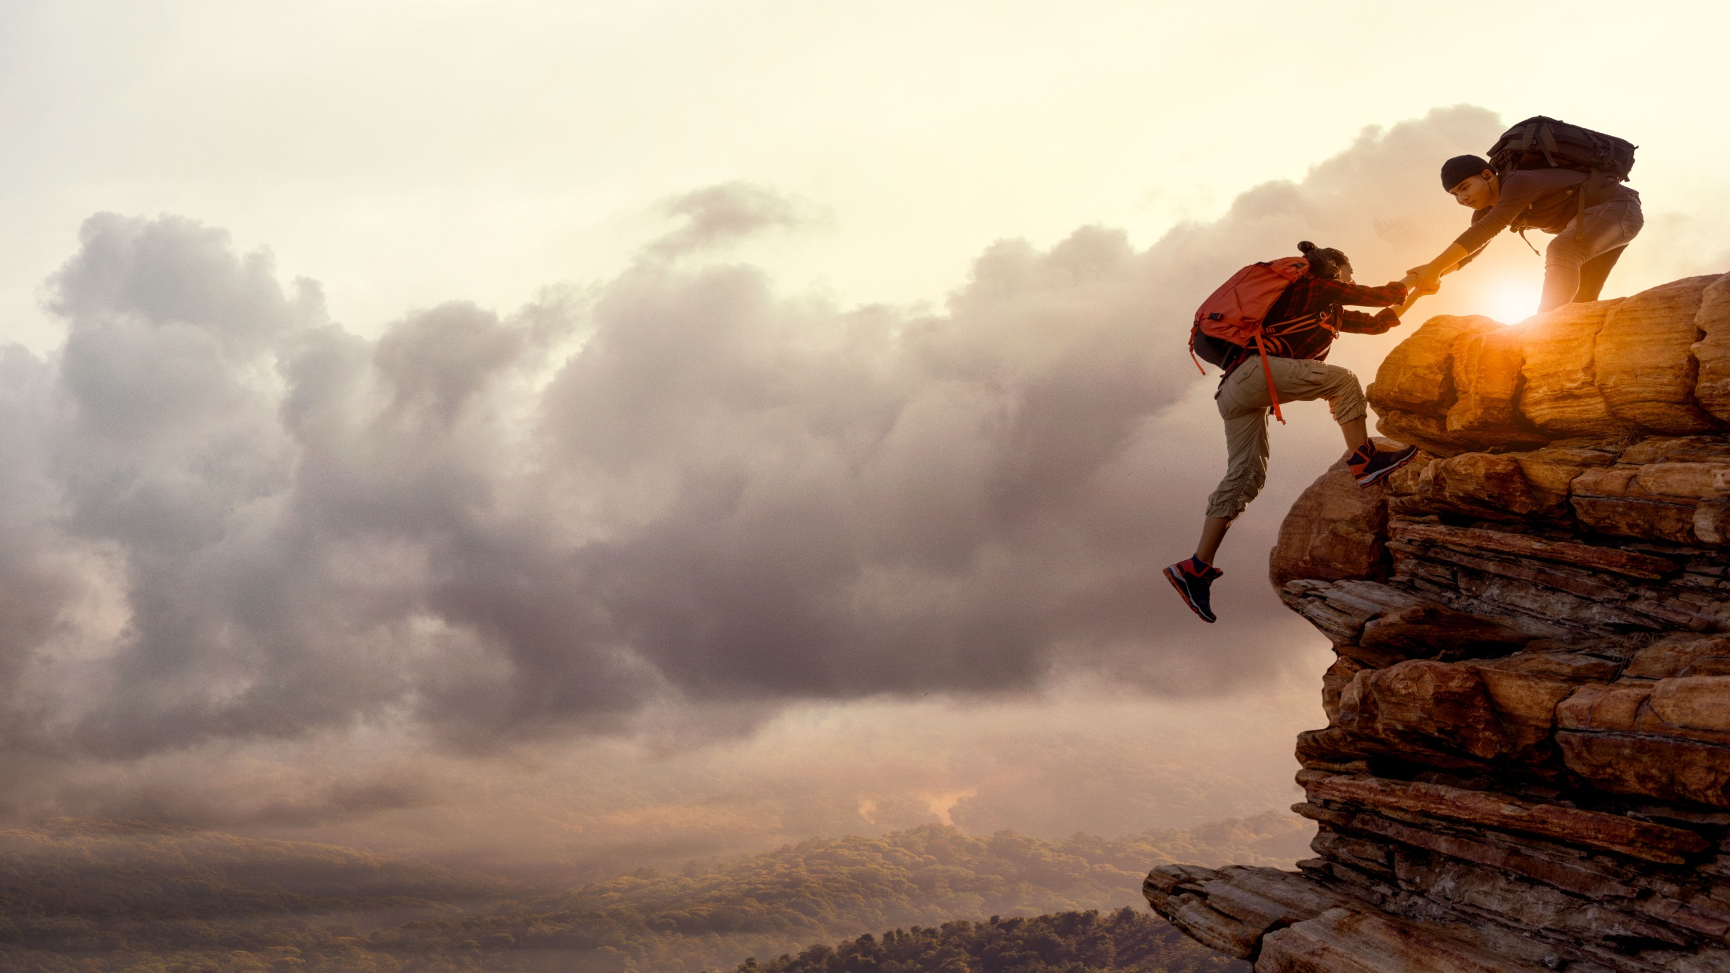
Chapter 5
What were They Doing?
Notes:
Jika terdapat gambar cantumkan sumber gambar dgn ukuran font 10pt

Slide 3
A. ……….
In this chapter, we will learn to:
identify past continuous tense both in spoken and written interaction;
use the past continuous tense both in spoken and written interaction;
read and respond to texts about past experiences;
locate and evaluate main ideas and specific information in texts;
communicate ideas and experiences through simple and organised paragraphs.

Slide 4
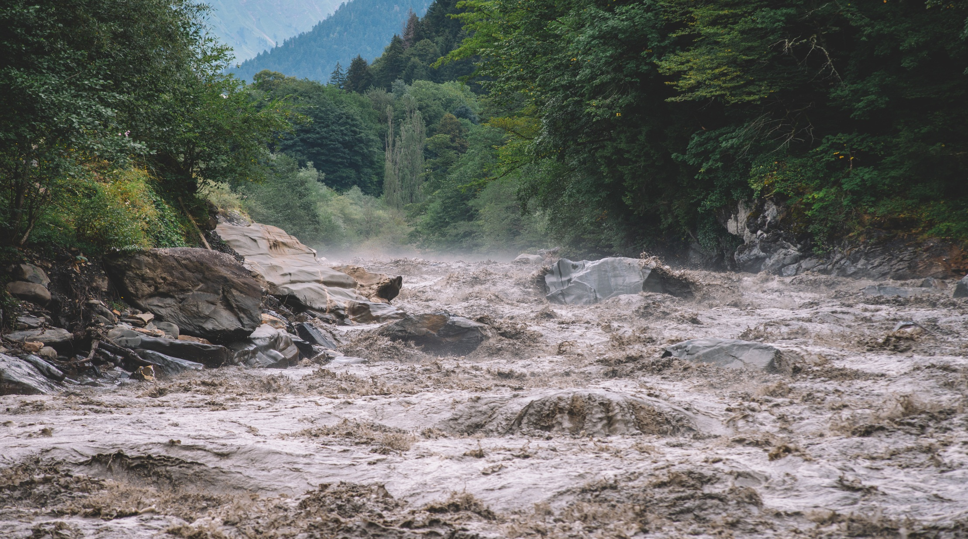
Read the following text.
It was a beautiful morning. I woke up early but stayed on my bed for a while to enjoy the green trees and breeze through the window of my bedroom. Suddenly, I heard a shout. It was my mum. I couldn’t catch clearly what she said, but soon I heard a loud and quick knock on my door. My mum insisted me that I go out. She sounded panicked. I rushed out to open the door and she told me that there was flood coming. At that point, I heard our neighbours outside were screaming about the flood coming, too. Mum ordered me to put our television set on the cupboard to save it from the water. I did accordingly. Then, I ran into my bedroom and tried to save my books and paper by putting them on the top of my closet. Not long after that, something rushed into the lower part of the closed front door. Our living room was soon full of mud! Seeing the thing, we realized that the flood was not water, it was mud. The mud of the Mount Merapi cold lava which had exploded several days ago. In only five minutes, the mud had reached the height of my knees, then it went up faster, to my hip, and to my chest. I told mum to go outside and climb the roof. After struggling on the slippery pole, we managed to reach the roof. We sat there and sadly watched the mud swallowing almost everything we had.

Slide 5

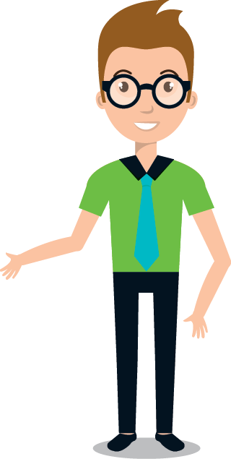
The Past Continuous Tense
We use the past continuous tense to talk about actions that were going on or happening at a certain moment in the past.

Slide 6
Study the pattern:
We form the past continuous tense like this:
Was + present participle (Verb 1 + ing)
Were + present participle (Verb 1 + ing)
The words was and were are called helping verbs, or auxiliary verbs. They help to form the past continuous tense when you joint them to the present participle of the verb.
Examples:
1. She was sleeping. 3. He was having dinner.
2. We were talking. 4. They were watching TV.
Examples:
1. Mum was cooking the dinner.
2. You weren’t listening, were you?

Slide 7
More examples:
• Tom was doing his maths when his sister came.
• We were waiting for the bus when Martin passed by.
• We were all enjoying the party when suddenly the lights went out.
• What were you doing when the phone rang?
Besides when, while is often used to connect clauses. In the past forms, while is used when two activities happening at the same time in the past.

Slide 8
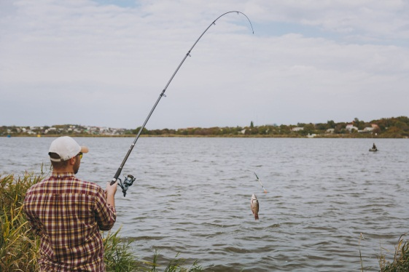
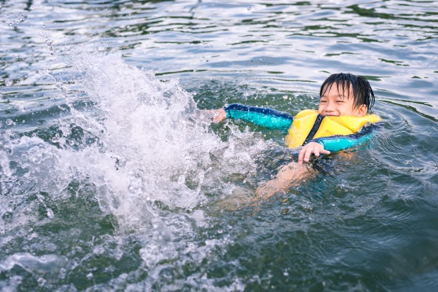
Daddy was fishing.
I was swimming.
Daddy was fishing, while Hendrik was swimming.
More Examples:
While daddy was fishing, I was swimming.
I was swimming while daddy was fishing.

Slide 9
GOOD JOB!

